Slide 1
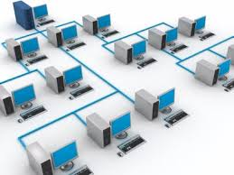

CHAPTER I
COMPUTER NETWORK

Slide 2
Have you ever used an ATM?
Have you ever transferred songs from your computer to a cell phone or vice-versa?

Slide 3
If the answer is YES, then you have experienced and utilized the services of a computer network.

Slide 4
Why Networking ?

Slide 5
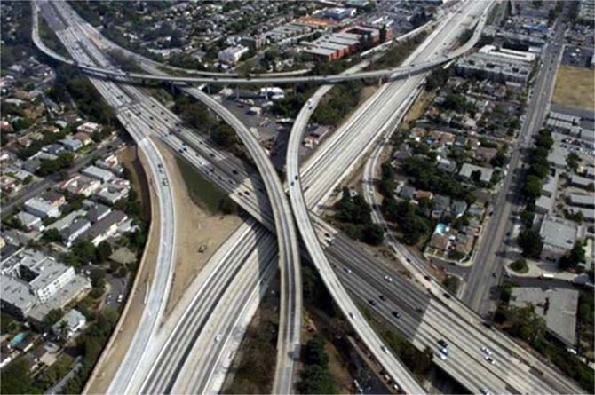
Road Network
Well-designed, connected road network /Streets make travel more efficient by providing choice not only in modes, but also in routes.

Slide 6
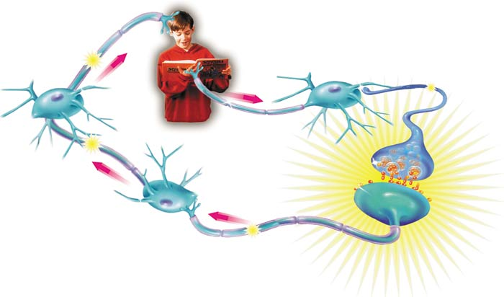
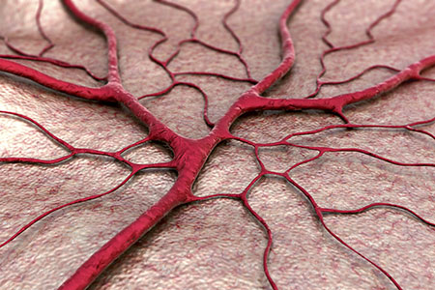
Network of neurons
Similarly network of neurons helps
transfer of impulse within seconds & blood vessels transport blood to all the body parts.
Network of Blood Vessels

Slide 7
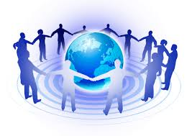
Same is for other networks also.

Slide 8
Computer network A collection of computing devices that are connected in various ways in order to communicate and share resources.

Slide 9
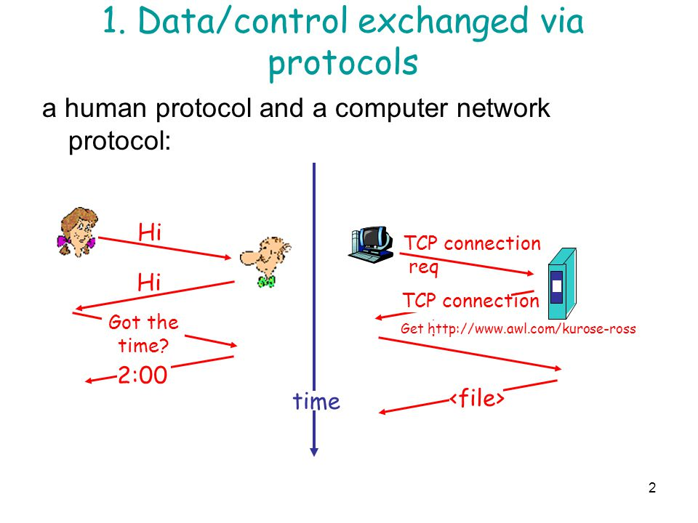
A computer network allows computers to exchange data.

Slide 10

Use of Networking
Simultaneous access to data
  Data files are shared
  Shared files stored on a server
  Software can be shared

Slide 11
Cont..

